Slide 1
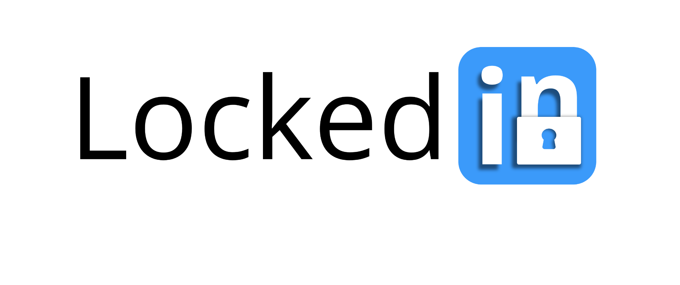
Introducing:
Effortless, personalized study groups tailored to your schedule, preferences, and learning styles

Slide 2
How does work?
We collect information from students in classes and use AI enhanced tools paired with research on effective collaboration practices to automatically plan recurring study sessions and manage group projects
Notes:
HMW’s Generated: 1. HMW... make opening up to other students less confrontational?
2. HMW... encourage collaboration amongst students with similar academic goals?
3. HMW... make connecting with other students fun, welcoming and productive?
4. HMW make resources easier to share/create a culture of sharing?
5. HMW eliminate the fear of reaching out to other students and sharing resources?
6. HMW... help students how to navigate their applications more effectively?
7. HMW create a more welcoming space for high school students working on college applications?
8. HMW create a more transparent system to show students what college admissions officers look for in students?
9. HMW... gameify application processes so they are more rewarding?
10. HMW ensure students are equipped with the best college app resources without the need for peer interaction?

Slide 3
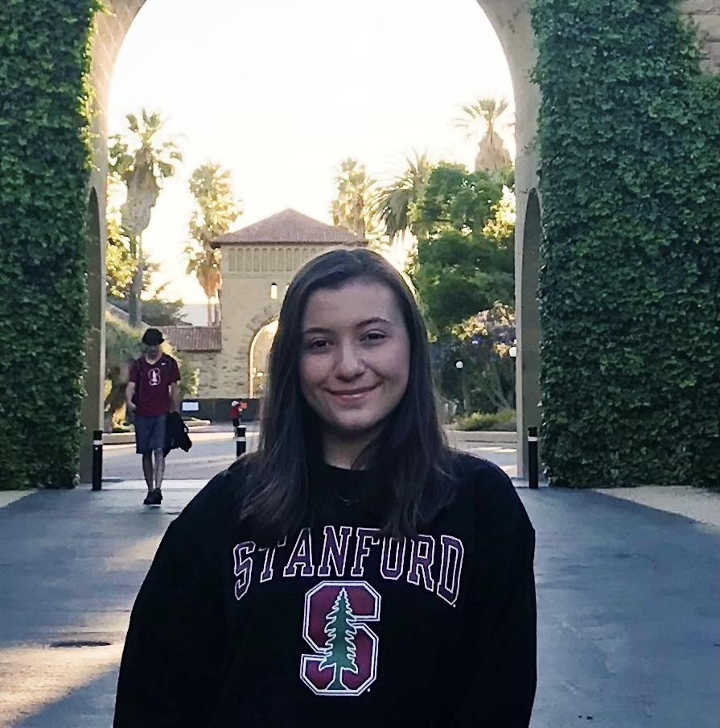
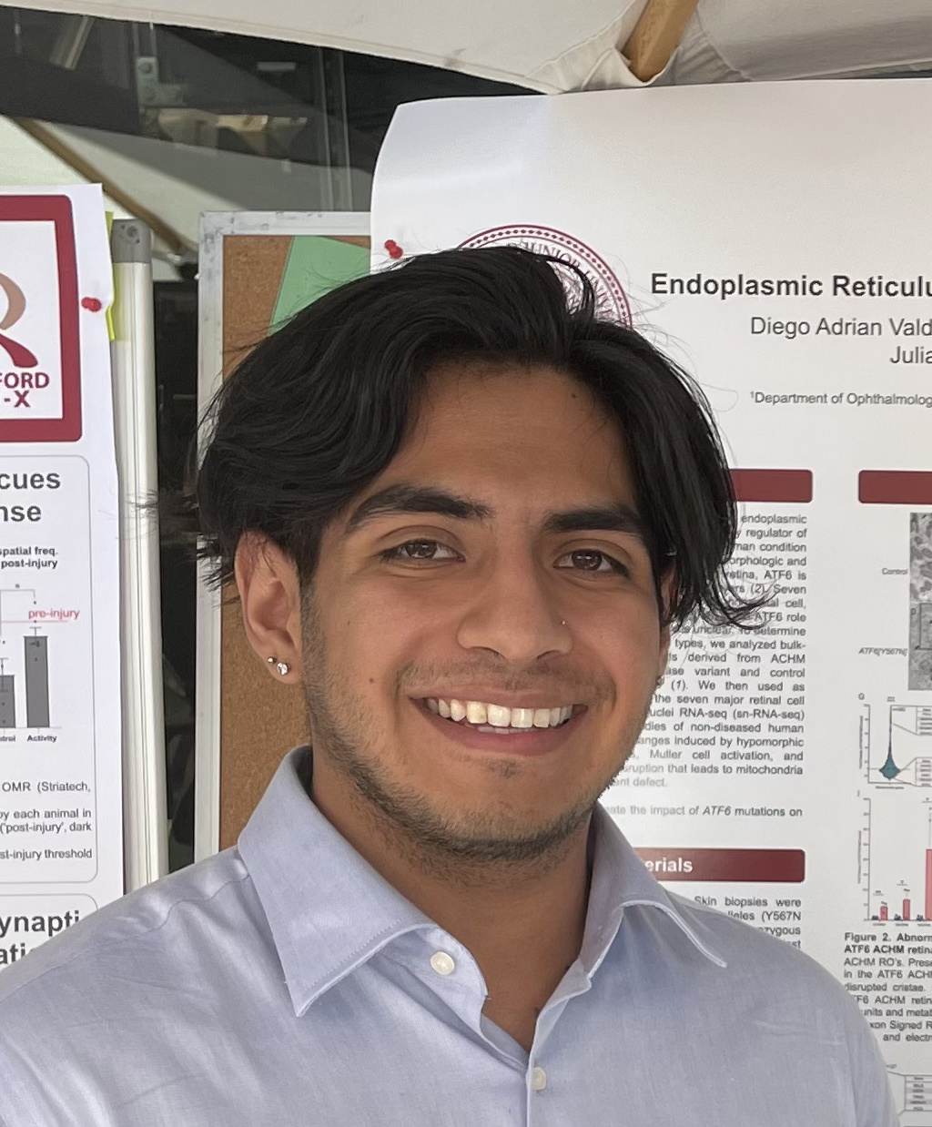
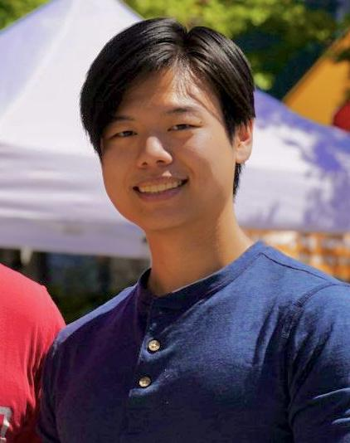
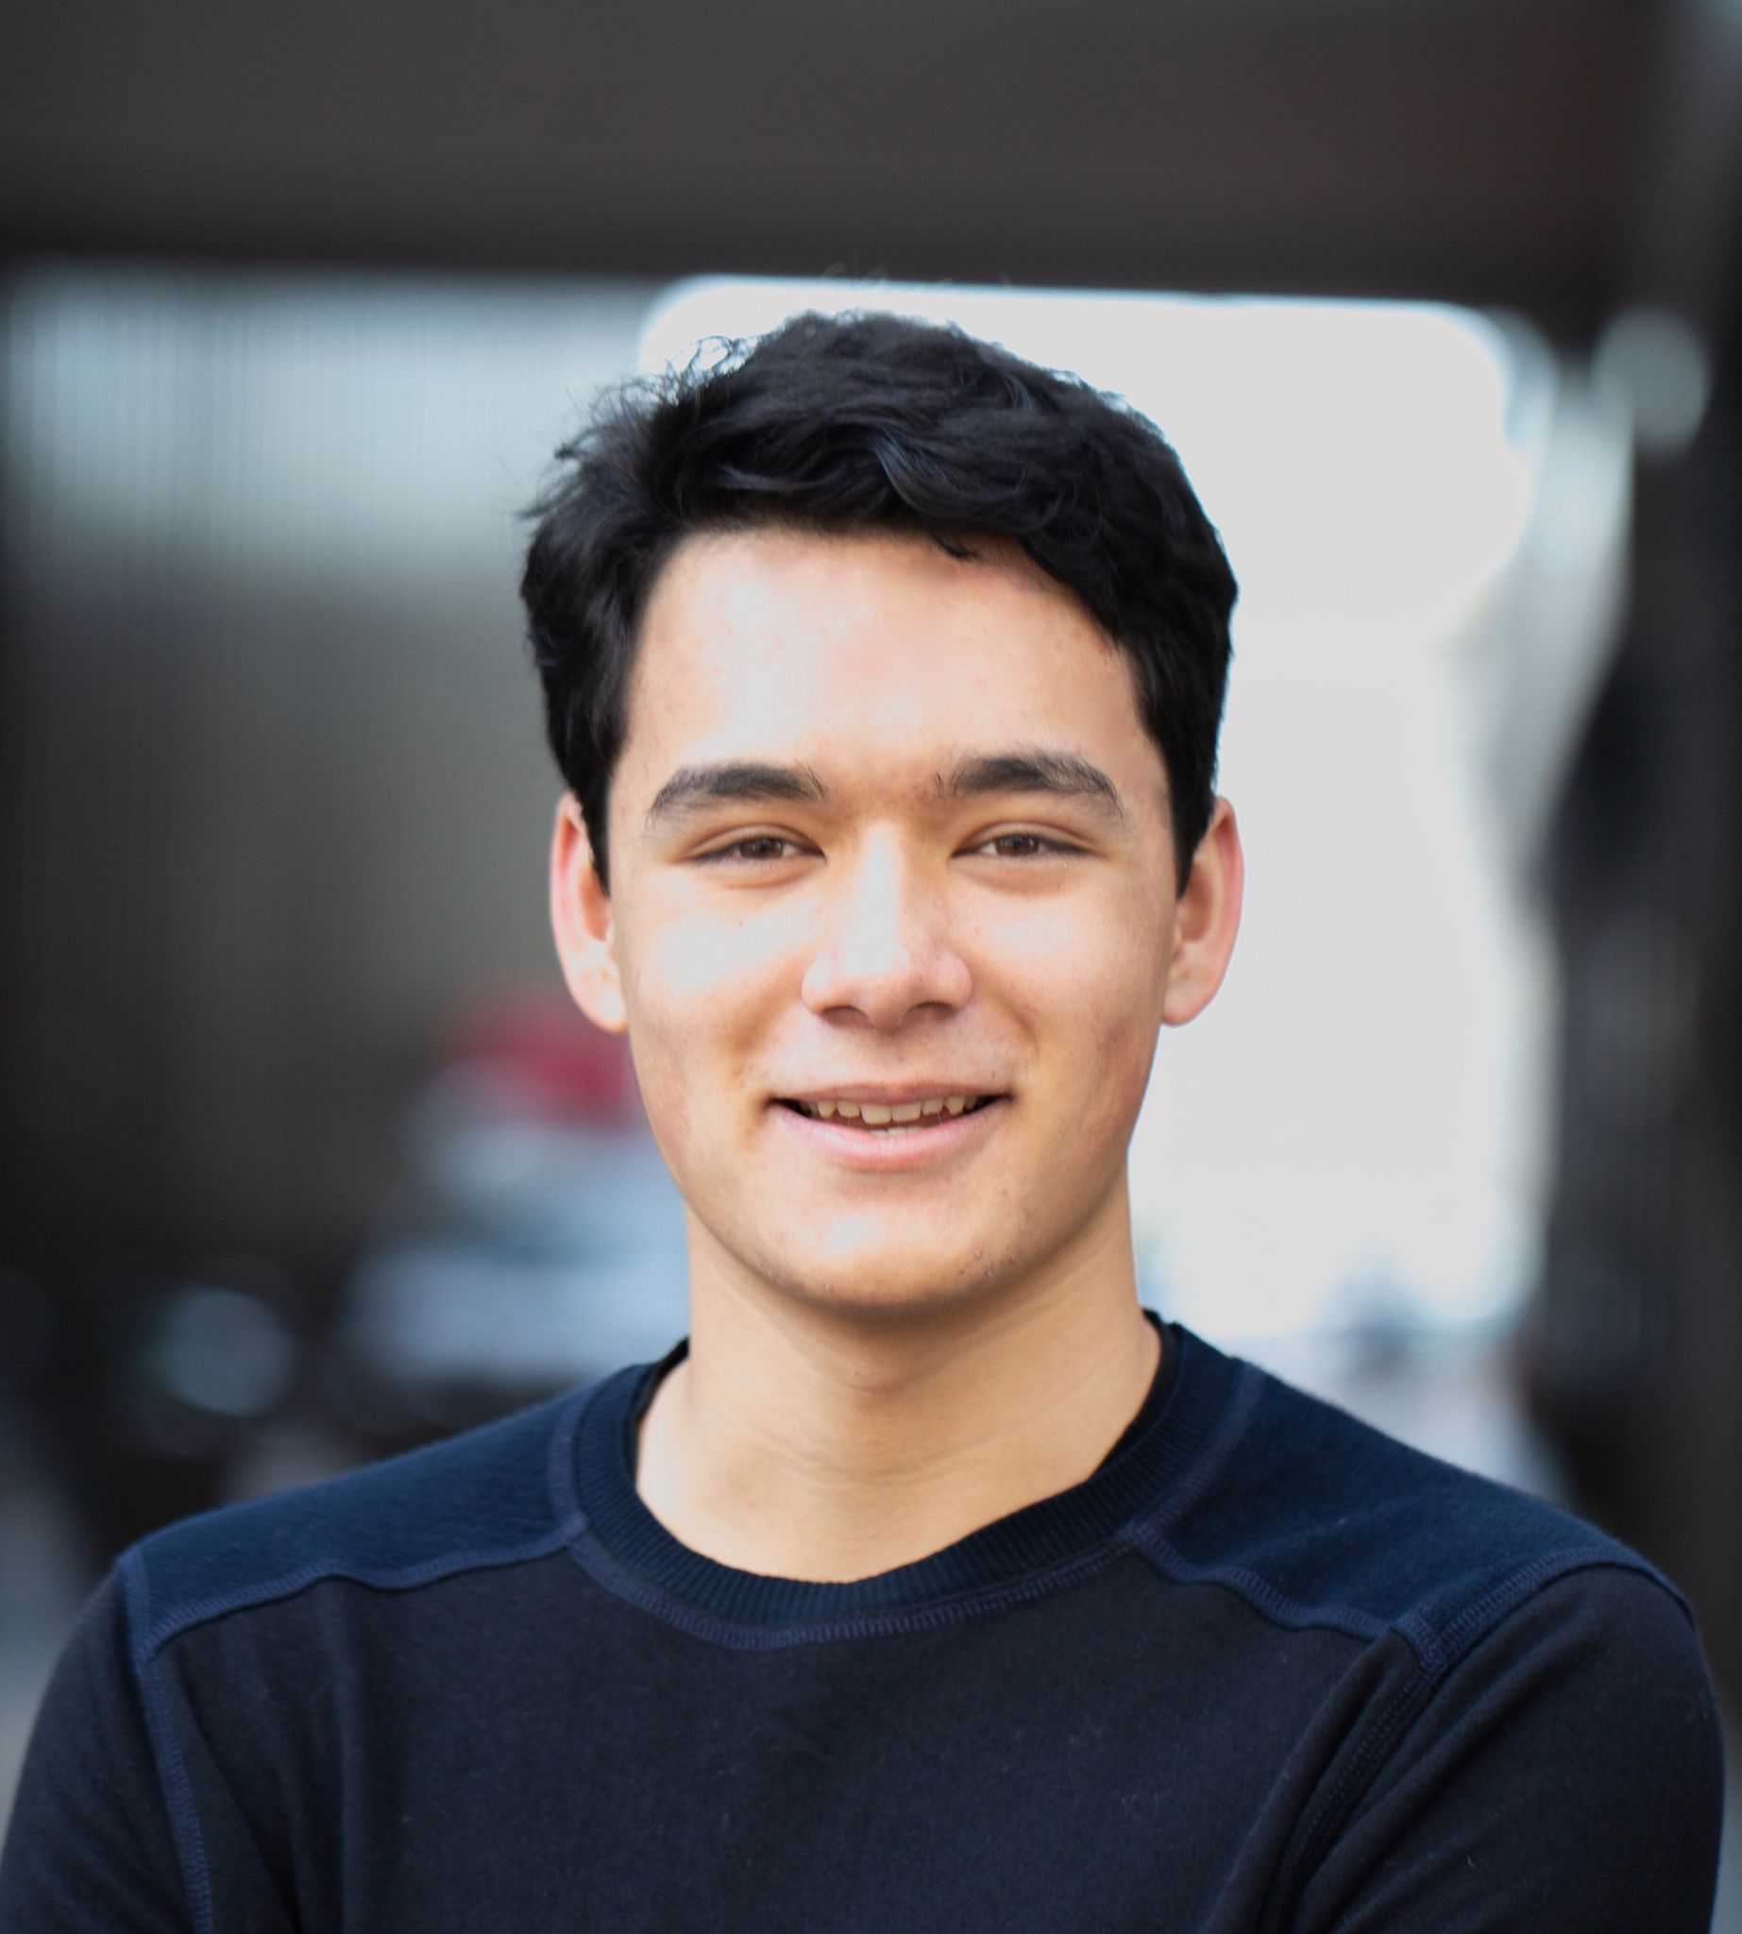
Meet The Team!
’25
Alexander Yue
Evan Hsu
BS Physics
Sacramento, CA
’25
Coterm
Rancho Cucamonga, CA
Ecem Yilmazhaliloglu
Diego Valdez Duran
BS CS
Istanbul, Turkey
Coterm CS
Aspen, CO
’27
’25

Slide 4
A6:_| Lo-Fi_|_
Prototype
Team 2:
Alexander Yue
Evan Hsu
Diego Valdez Duran
Ecem “AJ” Yilmazhaliloglu

Slide 5
TABLE OF CONTENTS
01
02
03
04
05
06
Intro
Mood Board
Sketching
Lo-Fi Prototype
User Testing
Discussion

Slide 6
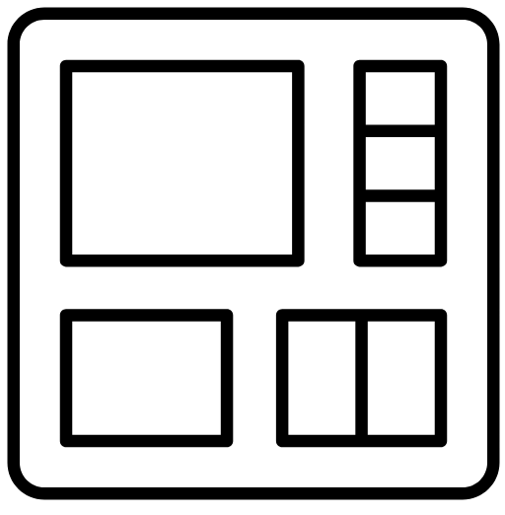
02
MOOD BOARD

Slide 7
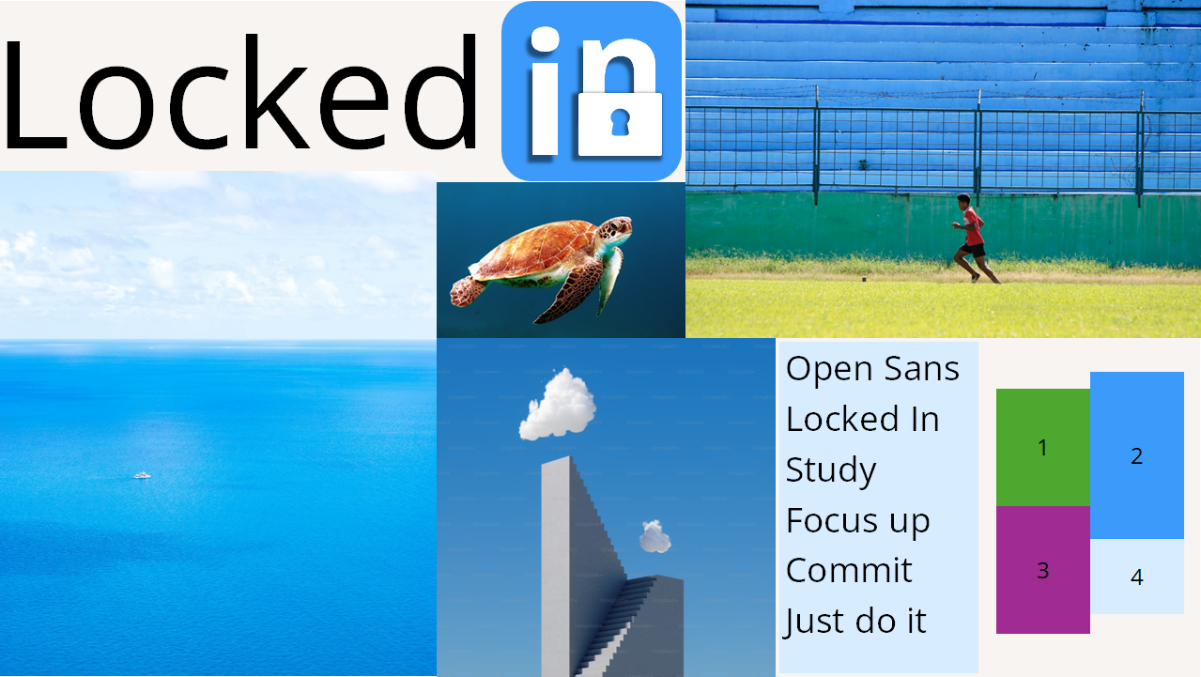

Slide 8

03
SKETCHING REPORT

Slide 9
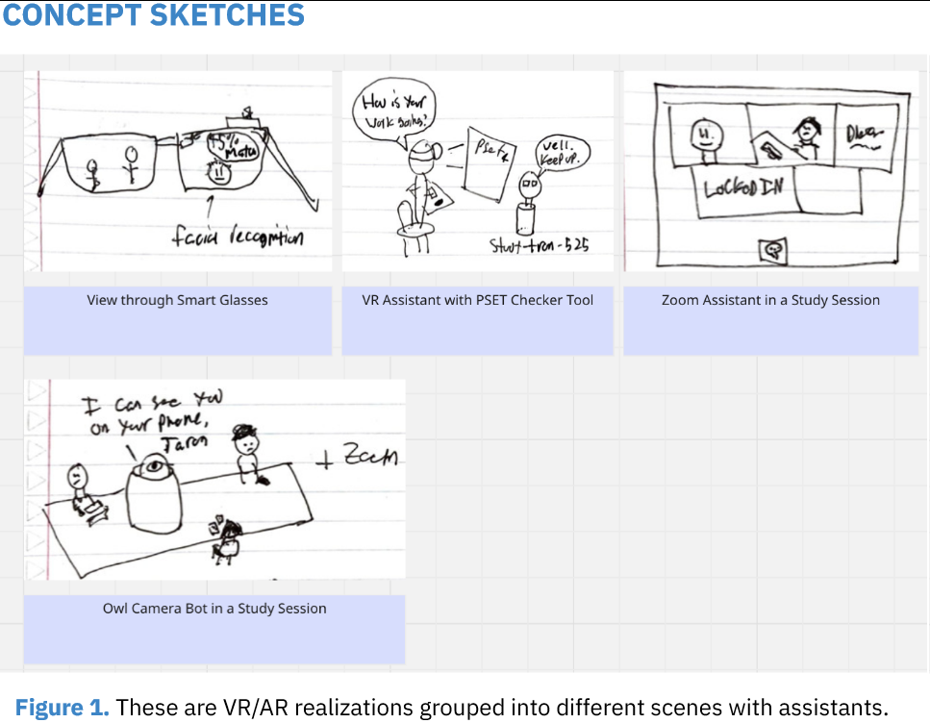

Slide 10
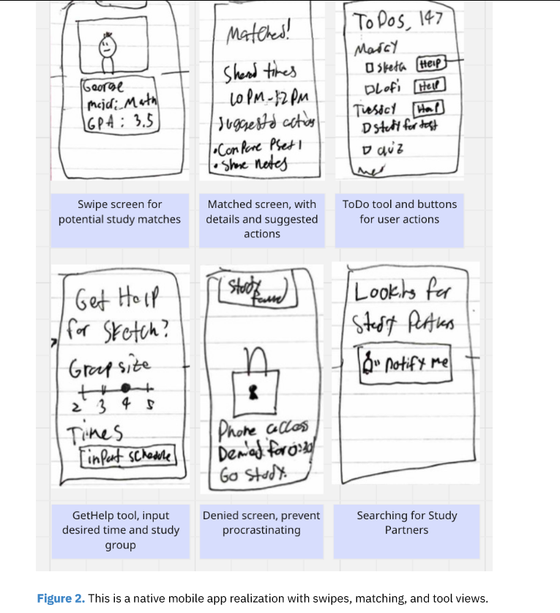
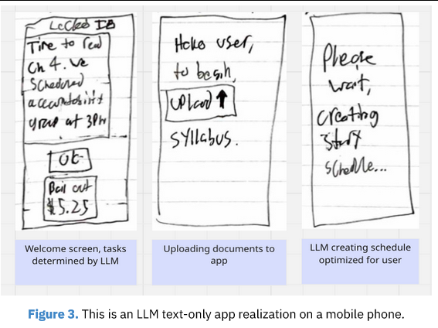

Slide 11
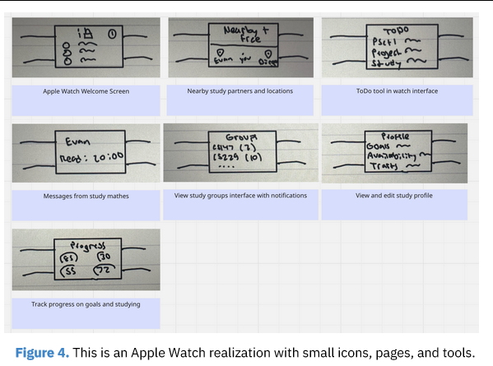

Slide 12
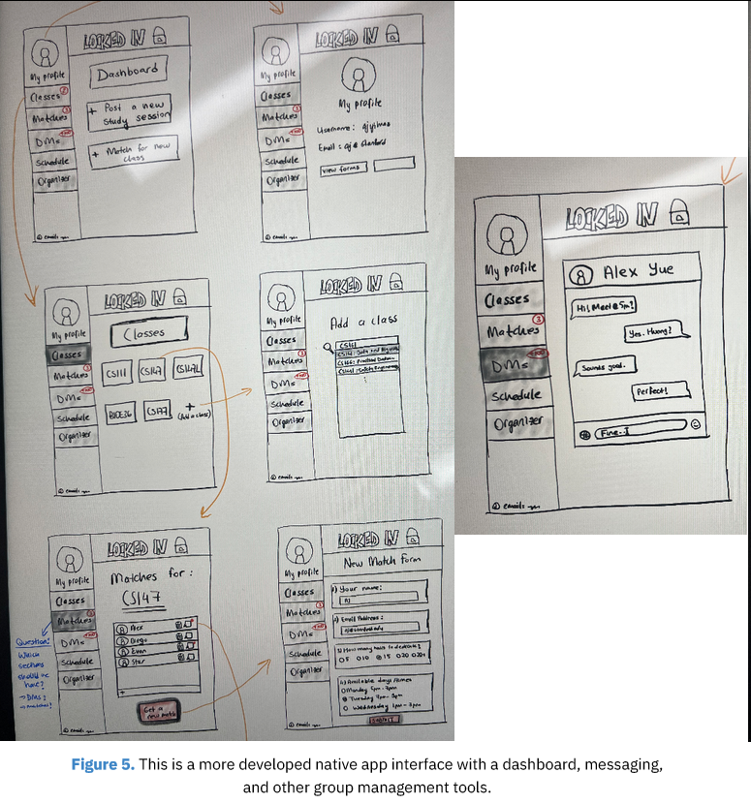

Slide 13
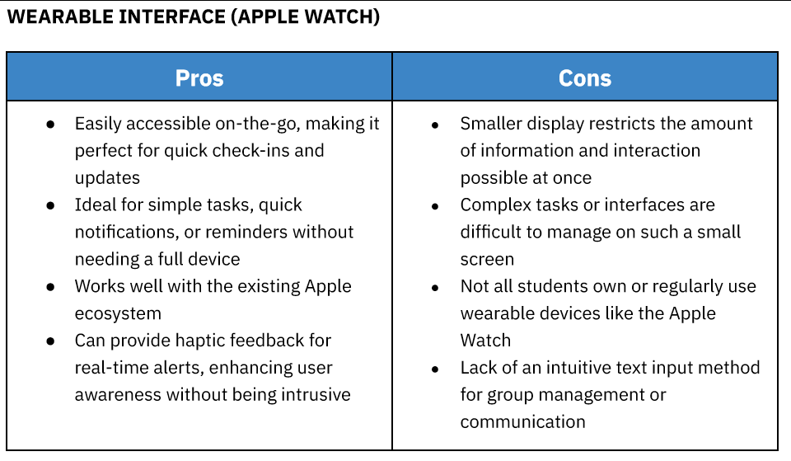

Slide 14
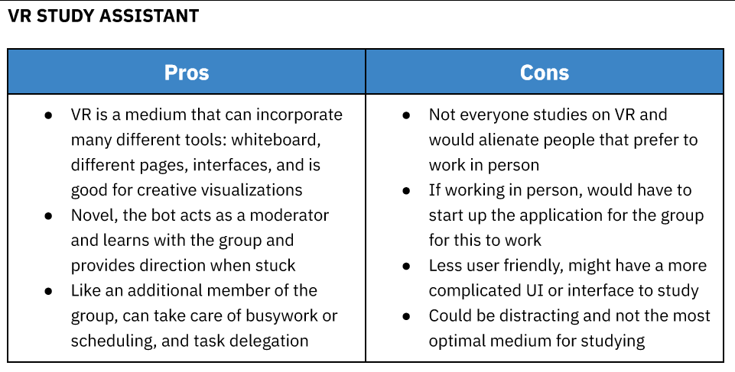

Slide 15
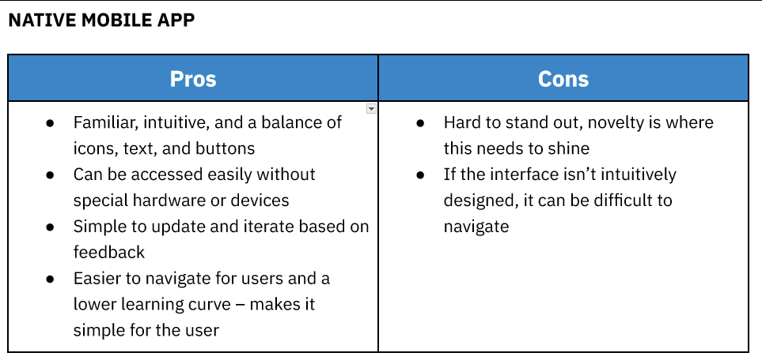

Slide 16
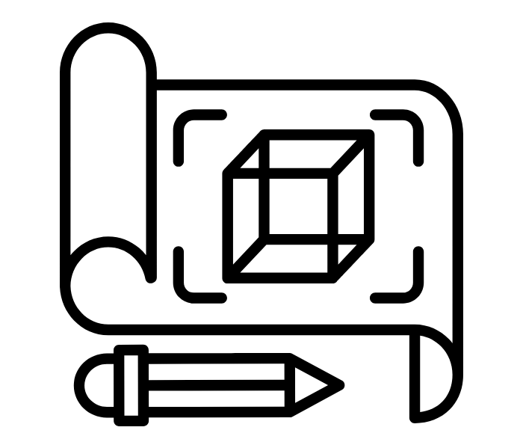
04
LO-FI
PROTOTYPE

Slide 17
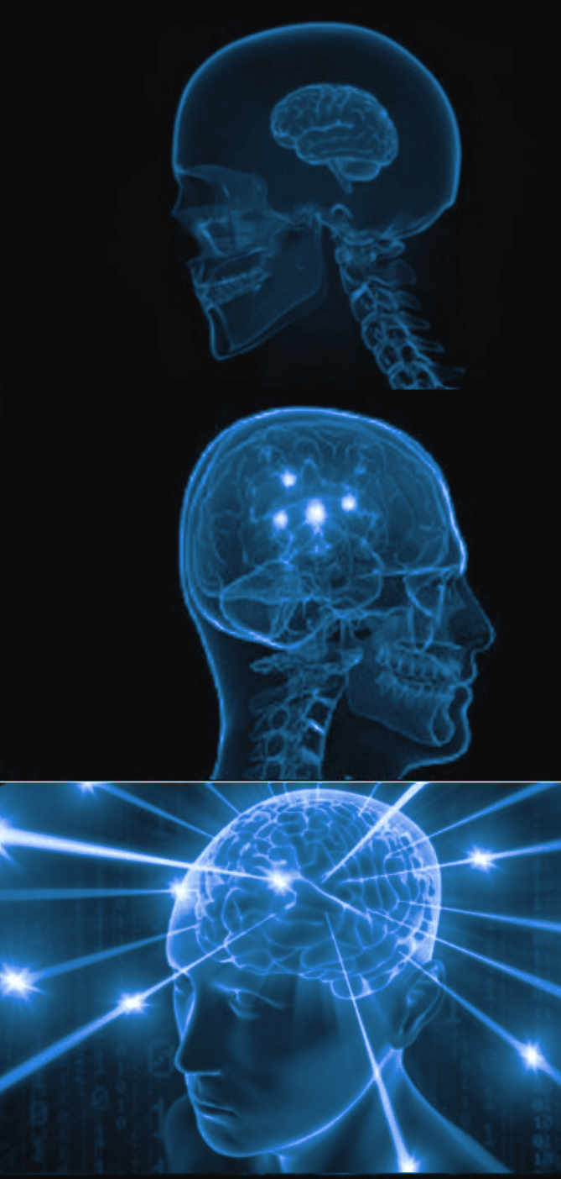
Simple
The user can discover public open study sessions for a class
Moderate
the user can upload class syllabi and assignments to get AI powered study plans and group project task delegation
Complex
the user can create a study profile and get matched with recurring partners/study groups

Slide 18
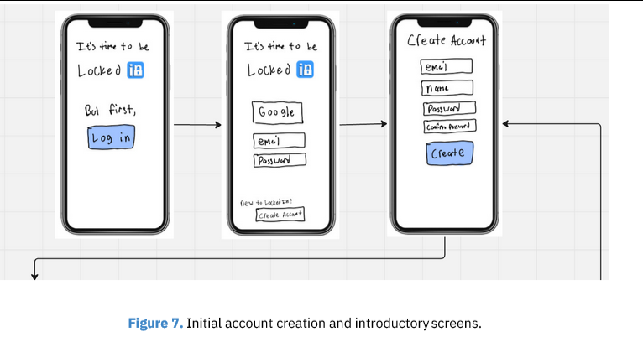

Slide 19
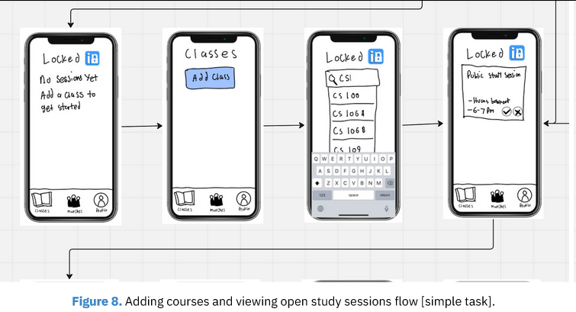

Slide 20
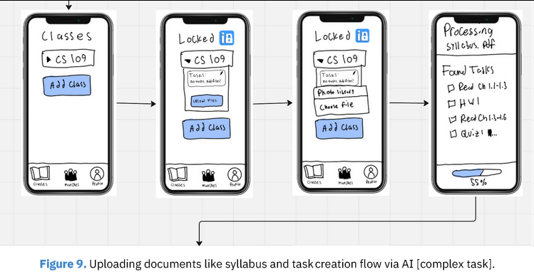
Moderate Task

Slide 21
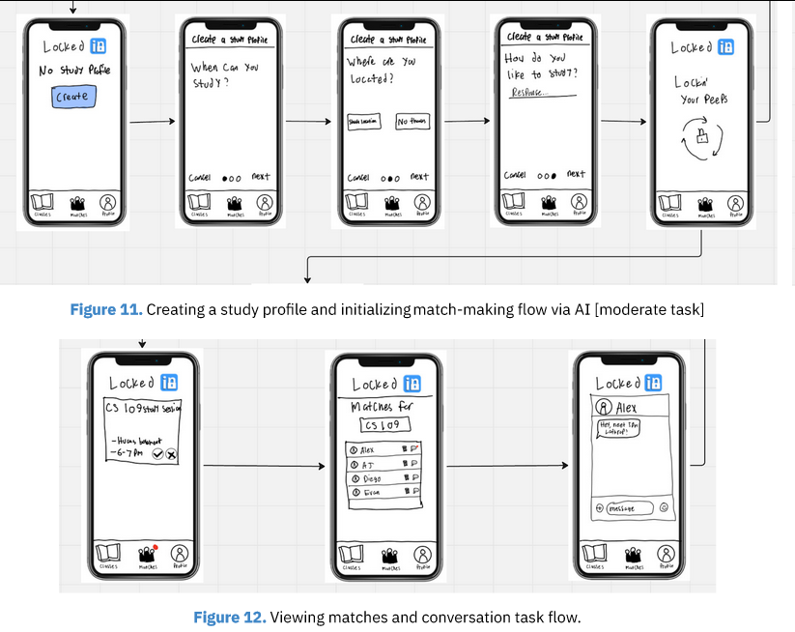
Complex Task

Slide 22
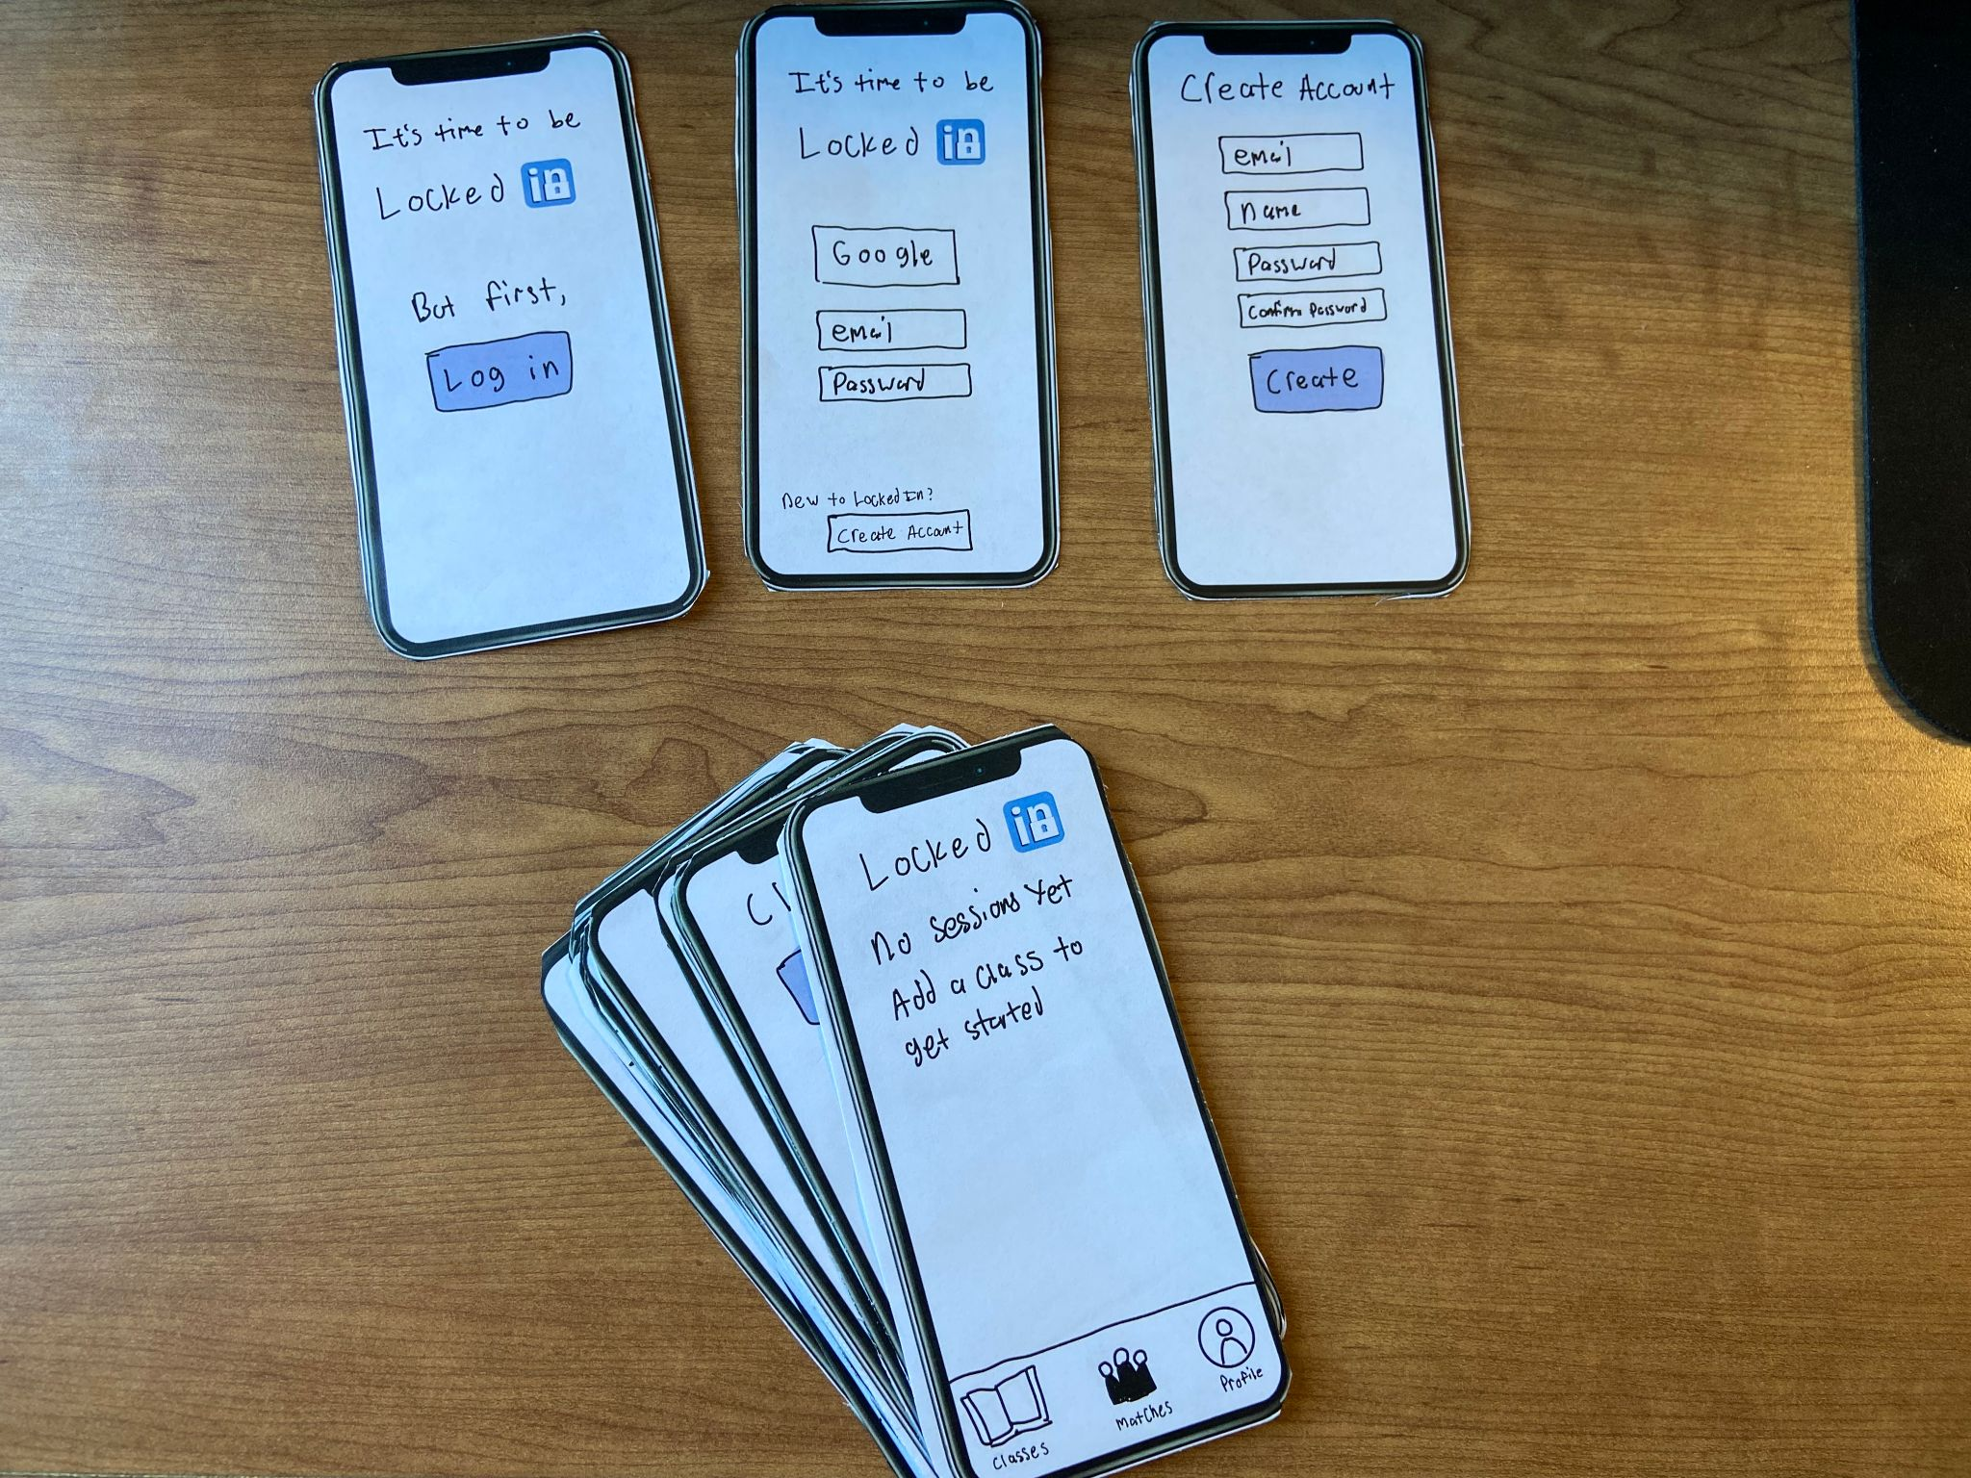

Slide 23
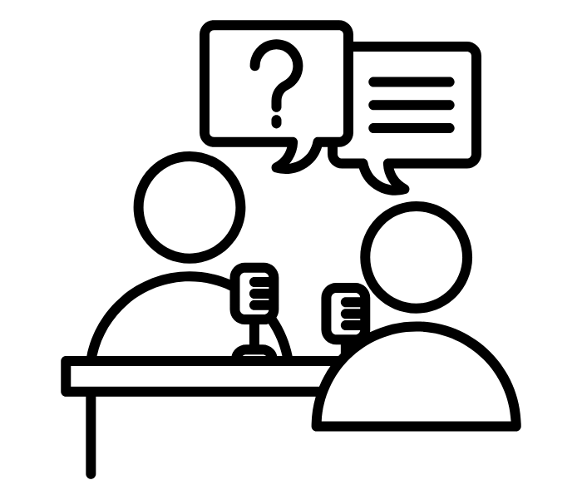
05
USER TESTING

Slide 24
User Testing Process
Found users from our target demographic (undergraduate students)
Channels: Asking friends & dorm slack if they have friends or family visiting from other colleges
Lo-Fi realization: Printed and cut out drawn phone screens
Operation: User speaks aloud their process and uses hand gestures. Computer hands the appropriate next screen
Recording methodology: Hugging laptop method.
Analysis methodology: We watched the recordings afterwards and noted the critical incidents
Compensation: Varied, but was easy and effective to buy boba for the user as compensation

Slide 25
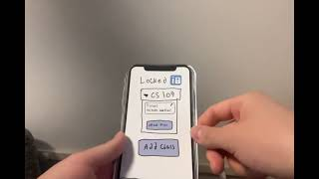

Slide 26

User Test 1 - Senior at Stanford
Context
Critical Incidents
Originally from Portland
International Relations Major
Chair at Democracy Day
Met at EVGR (on-campus), in his room
No compensation needed
Roles: AJ facilitated, Diego took notes
[3] Didn’t understand which tab he was on and said he wished he could see which bottom looked “pressed on” to have a sense of where he is
[0] Navigated the prototype without any challenges or clarifying questions saying that it was “intuitive”
[0] Understood our mission and tasks clear and told the interviewer directly, without prompting
[2] Wished that the time windows in the questionnaire were more flexible
Stock Image by StockImages

Slide 27
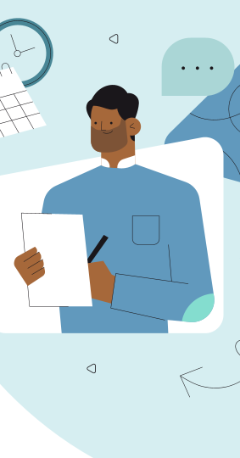
Key learnings
Could use more responsiveness when switching between tabs (task flows) in the footer
Wants more open flexibility and detail
in the study profile survey
Notes:
Engagement- working in smaller groups and interesting guest speakers
Personal barriers: ‘imposter syndrome’, social anxiety

Slide 28

User Test 2 - Junior @ Cornell
Context
Critical Incidents
Hometown in bay area
Sibling of someone in my dorm
Compensated with boba
Roles: Alex facilitated, Evan took notes
3 Didn’t notice red notification on profile tab, was confused for several seconds
0 Was easily able to select possible study times in the future (assumption #2)
0 Answered placeholder questions on study habits
2 seemed disappointed that only responsiveness to accepting study session was a blue circle check mark
3 didn't notice red notification on matches tab, was confused for several seconds
Stock Image by Unsplash

Slide 29
Key learnings
Need to direct user between task sections in a obvious and intuitive way
Need more responsiveness and juice for accepting study sessions
Notes:
Engagement- working in smaller groups and interesting guest speakers
Personal barriers: ‘imposter syndrome’, social anxiety

Slide 30
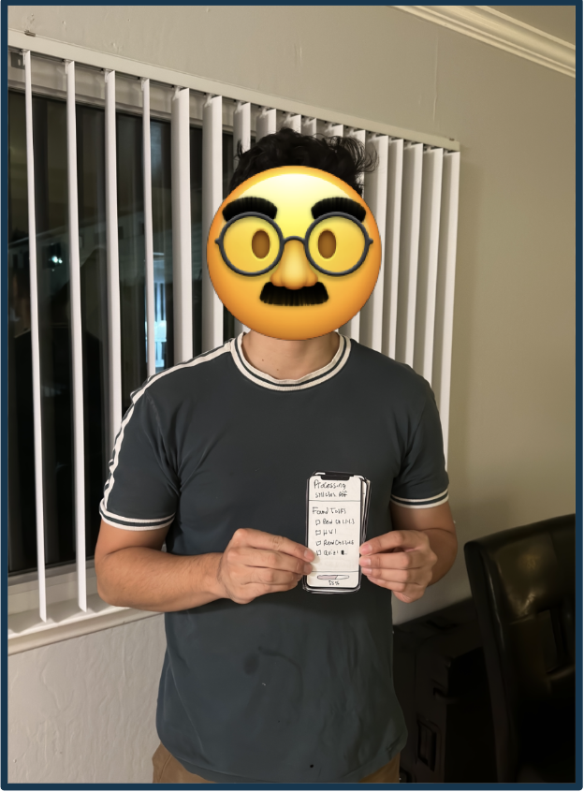
User Test 3 - Senior @ SJSU
Context
Senior at SJSU
Friend of a friend
Bought them Boba + Korean Corn Dogs
Roles: Diego facilitated, AJ took notes

Slide 31
User Test 3 - Senior @ SJSU
Critical Incidents
[0] Create an account and login. Process was seen as easy, familiar, and “standard” to an everyday app.
[1] Add a new class. Was a little confused on what was going on after being redirected to homepage. User noted they would have wanted “a little blurb to tell me what the app is for and how it functions in the beginning”
[1] Upload class materials. The process of uploading materials was good, but was unclear on what was uploading and why.
[3] Take the profile survey. Felt that building profiles should be class specific, may have different goals for different classes. Was disappointed in lack of responsiveness when getting a study group match.

Slide 32
Key learnings
Could use landing page / features overview at the beginning of the user experience
Need more exciting user flow from completed profile to matches and match requests
Need signposting on purpose of uploading class materials
Some users want class-by-class customizability in user survey
Notes:
Engagement- working in smaller groups and interesting guest speakers
Personal barriers: ‘imposter syndrome’, social anxiety

Slide 33
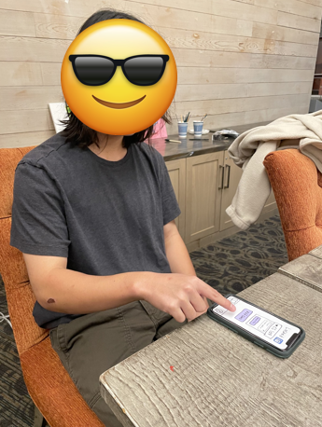
User Test 4 - Sophomore at Santa Clara University
Context
Sophomore at Santa Clara University
Roommate's brother who came to visit earlier
No compensation needed
Evan facilitated, Alexander took notes

Slide 34
User Test 4 - Sophomore at Santa Clara University
Critical Incidents
Directed to complete 3 tasks
Create an account and login
He thought the process was quick and easy
Add a new class
He was confused after being redirected to homepage after adding a class. “I want to be able to immediately see the changes I made”
Upload class materials
He was unsure of what the purpose of uploading materials was after navigating the process
Take the profile survey
He preferred being immediately redirected to match requests after completing the survey

Slide 35
Key learnings
Need to clearly display newly added class immediately after adding it
Need more direct user flow from completed profile to matches and match requests
Need signposting on purpose of uploading class materials
Notes:
Engagement- working in smaller groups and interesting guest speakers
Personal barriers: ‘imposter syndrome’, social anxiety

Slide 36

06
DISCUSSION

Slide 37
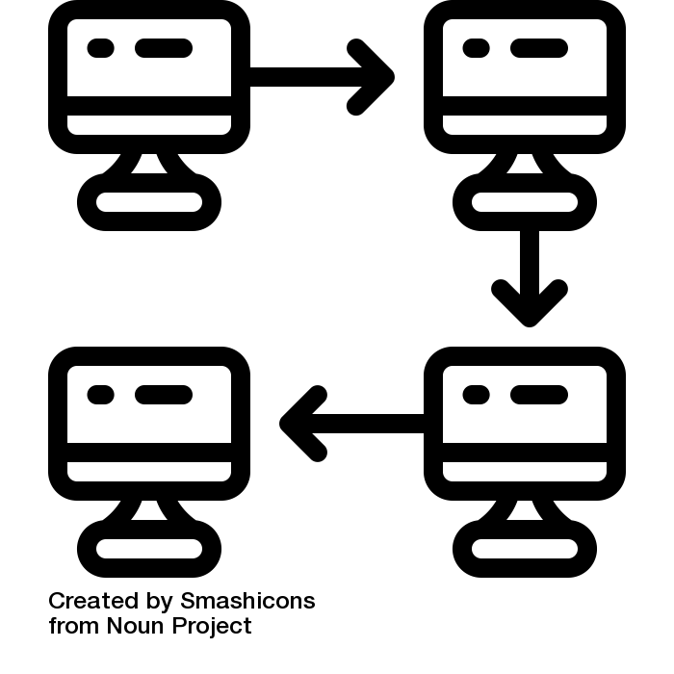

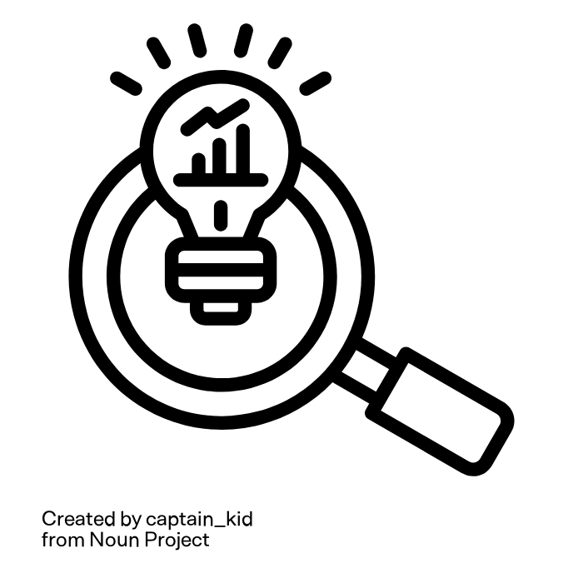


User Test Key Insights Summary
Task flows were largely successful, but user flow between tasks was lacking
A high level overview of how the solution works should be presented at the beginning
01
02
Completing tasks and getting results needs much more juice and interactivity
Study profiles should have different levels of complexity for different kinds of users
03
04

Slide 38
What’s Next?
Changes to make:
Focus on improving responsiveness and flow between different tasks in the Mid-Fi prototype
Add explanation of how features work and why to use them at the beginning of the user experience in the Mid-Fi Prototype
Features to further develop:
Investigate what complexity of study profile different students want and make preliminary surveys at 3 levels
Explore suggested idea of banner notifications for when users get a study partner match or a study group invitation

Slide 39

07
NO APPENDIX
(All content in above slides)

